Slide 1
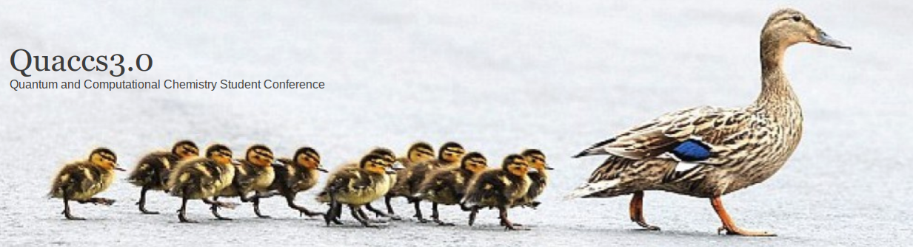
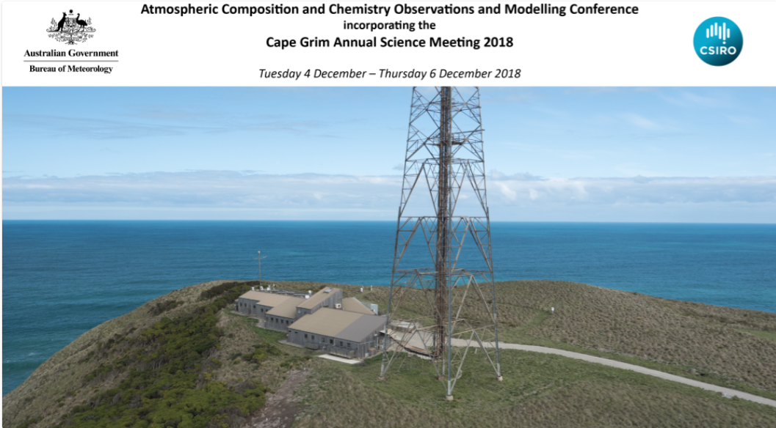
Conference(s) debrief: QUACCS & ACCOMC
Keiran Rowell - Group Meeting - 18th Jan 2019

Slide 2
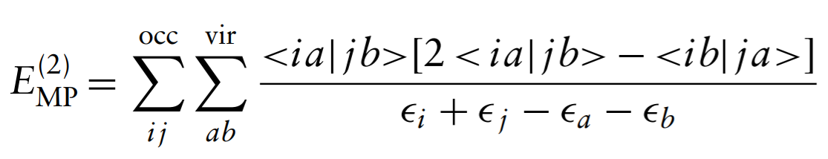
QUACCS - Write your own MP2 - Simon McKenzie
Cremer D., WIREs Comput Mol Sci 2011, 1, 509-530.
Workshop less about MP2 than its implementation
In brief:
First level of theory to include e⁻-e⁻ correlation.
Perturb with virtual orbitals from HF solution.
H = H_{o} + λV
E = E^{(o)} + λE⁽¹⁾ + λ²E⁽²⁾ + λ³E⁽³⁾ + …

Slide 3
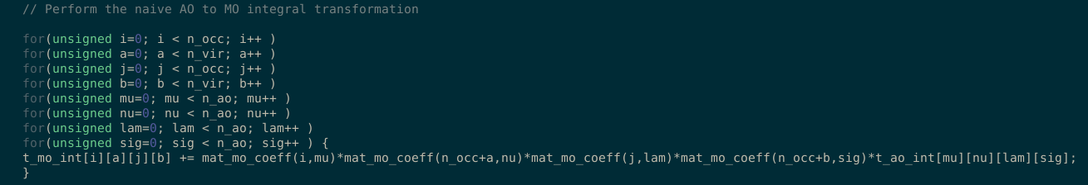
The importance of loops
Since you are calculation electron repulsion integrals (ERI), many permutation loops.
► Naive implementations scale as O(N⁸)!
►
► Conventional implementations scale as O(N⁵) or better
⬩Preference looping over occupied (i,j) rather than virtual (a,b) orbitals — many more virt. orb.s
⬩Piecewise MO -> AO transformation ⬩ERI pre-screening ⬩ 4e⁻→3e⁻ & 2e⁻ integrals w/ aux. basis

Slide 4
ACCOMC - Testing estimates of terrestrial productivity using carbonyl sulfide - Peter Rayner
1 Kettle A., Kuhn U., von Hobe M., Kesselmeier J., Andreae M., J. Geophysical Research, 2002, 107, 4658
2 Protoschill-Krebs G. Kesselmeier J., Plant Biology, 1992, 105, 206-212
3 Brasseur G., Jacob D., Modelling of Atmospheric Chemistry, 2017, Cambridge University Press, Cambridge.
►S=C=O (COS) most abundant sulfurous compound (0.5 ppb) in the atmosphere¹
Sources: CS₂ oxidation, oceanic vents, soils, biomass burning
► Loss mechanism is from vegetation,² CO₂-fixing enzymes making a mistake!
► ∴ COS direct tracer of plant fixing rates — Gross Primary Productivity (GPP)
► Inversion modelling is where you work backwards from atmospheric observations
Budget modelling: sum known sources & sinks
Inversion modelling: statistically estimate the variables driving an observation³

Slide 5
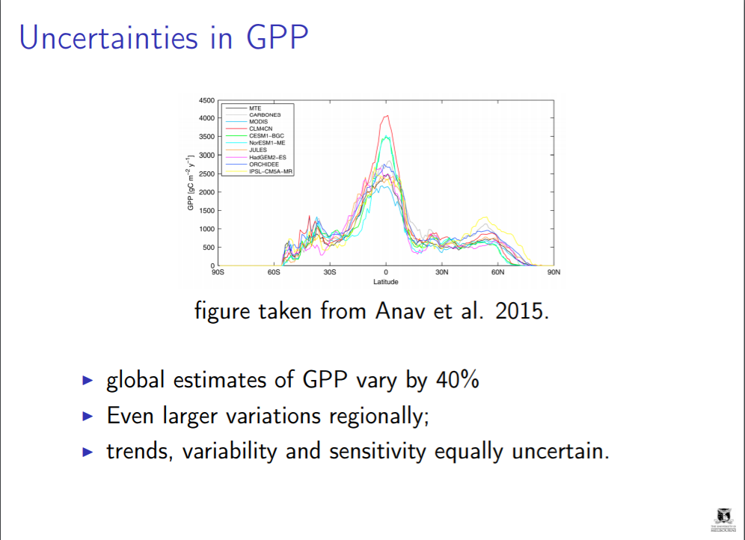
Sinks ∝ [COS]
F_{canopy} = λ x GPP x [COS]
λ = COS vs. CO₂ pref.
λ highly uncertain!
From known budget:
-Insert flux into transport models.
-Vary estimates of GPP & λ

Slide 6
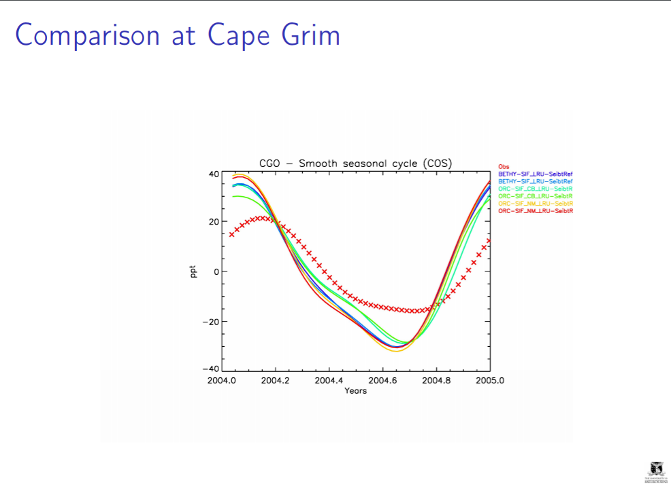

Slide 7
Future Work & Conclusions
1 Denning S., et al., Farquhar Photosynthesis Model, http://biocycle.atmos.colostate.edu/shiny/photosynthesis/, (Acessed 18th Jan 2019)
Future Work:
►Global & local inversion models attempt to constrain good estimates for λ
►Implement improved transport parameters & a photosynthesis model¹
Conclusions:
► Seasonal variance in [COS] offers a window to constrain GPP estimates
► Many confounding factors, but they don’t seem to affect seasonal variations
► No clear best estimate, location dependent
► Inversion modelling can quantify confidence. Need leaf uptake parameters.v

Slide 8
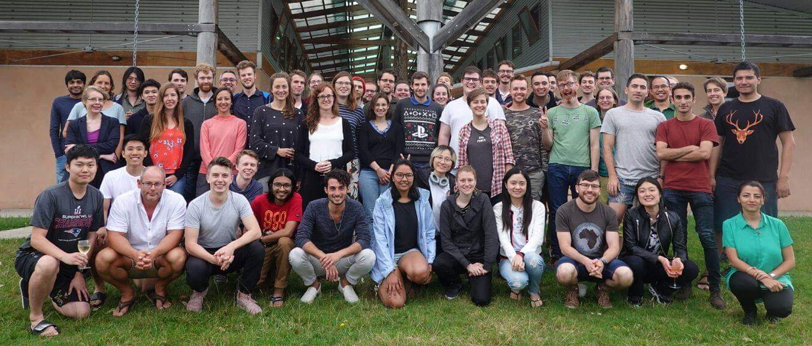
Thank you!

